Slide 1
Benchmarking
Overview of Policy and Impact on Un-Regulated Utilities
1/13/23

Slide 2
Agenda
Background on the Program
The experience for building owners
How regulated utilities provide building-level data to building owners
How unregulated utilities may respond to a data request

Slide 3
Guiding Authorities
The Clean Energy Act of 2018 calls for the benchmarking of commercial buildings by May 2023:
“No later than five years after the date of enactment of P.L.2018, c.17 (C.48:3-87.8 et al.) [by May 23, 2023], the board shall require the owner or operator of each commercial building over 25,000 square feet in the State to benchmark energy and water use for the prior calendar year [2022] using the United States Environmental Protection Agency’s Portfolio Manager tool.”

Slide 4
Guiding Authorities
September 7, 2022 BPU Board Order, Docket Number QO21071023
The Board HEREBY DIRECTS Staff to implement its recommended process by which [regulated] utilities will provide building owners with aggregated building-level data subject to the 4/50 rule and DIRECTS the utilities to follow this process and work with Staff to establish standardized forms, develop a process to identify meters in a building, and finalize any outstanding details of the statewide procedure for data aggregation. The Board also DIRECTS Staff to conduct outreach to unregulated utilities to encourage them to apply the 4/50 rule and provide aggregated building-level data according to the same process followed by the regulated utilities. The Board also DIRECTS Staff to develop and provide a Data Access Request Form and Consent Letter on the BPU’s benchmarking webpage as recommended by Staff.

Slide 5
What is Benchmarking?
The first step to saving energy at your building is to benchmark — that is, to measure and compare your building’s energy to similar buildings, past consumption, or a reference performance level.
Benchmarking turns the information on your utility bill into knowledge you can act on.
Notes:
Could be water or waste as well.

Slide 6
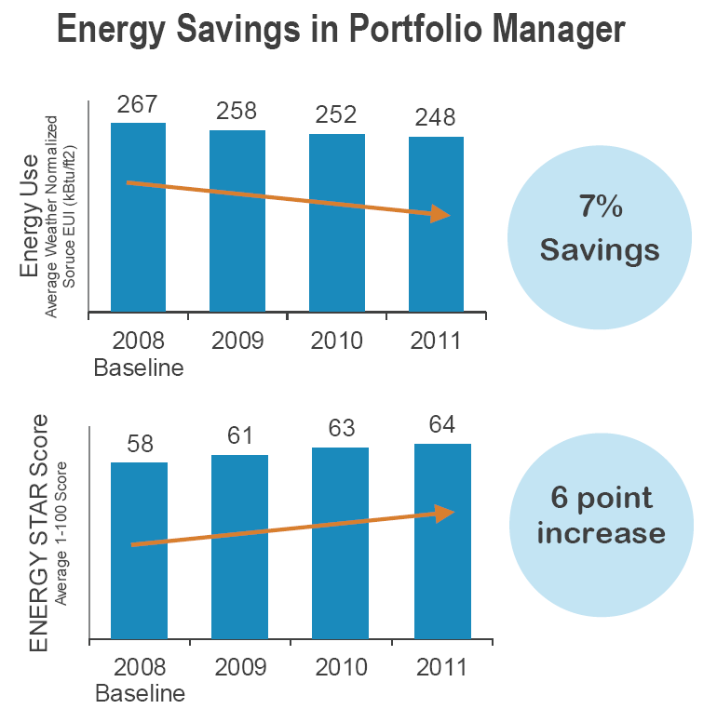
Benchmarking Enables Savings in Commercial Buildings
Consistent benchmarking in buildings promotes energy savings and improved performance
Source:
http://www.energystar.gov/ia/business/downloads/datatrends/DataTrends_Savings_20121002.pdf?8d81-8322
Notes:
An recent EPA analysis of more than 30,000 buildings that consistently tracked energy consumption in Portfolio Manager over a three year span showed 7% average energy savings and a 6 point ENERGY STAR score increase from 2008-2011.
For more information, see www.energystar.gov/datatrends.

Slide 7
Benefits of Benchmarking for Building owners
Identify underperforming buildings to target for efficiency improvements
Implement a comprehensive management program
Verify savings
Share and report performance
Earn recognition with Energy Star Certification
Benchmark more than energy (such as water use, waste and materials, and greenhouse gas emissions)

Slide 8
How Does Benchmarking Benefit Utilities?
Customer Needs Become Opportunities for Utilities
Increased customer satisfaction
Increased opportunities for customer engagement
Ability to position the utility as a trusted advisor
Better understanding of the “whole building” to support DER/GEBs strategies
Notes:
It’s important to note that customer demand for energy data should not be seen as simply a burden on the utility. In fact, a growing number of utilities are realizing that their customers’ need for energy data presents and opportunity. In particular:
Provision of streamlined access to whole-building energy consumption data can lead to greater customer satisfaction
Support motivated customers who want to benchmark as a key energy management activity
Make it easier for customers to participate in local initiatives
Make it easier for customers to comply with local mandates
Positive experience can make participation in utility efficiency programs more attractive
Facilitating benchmarking at greater scale magnifies opportunities for further and deeper engagement with existing customers
Providing streamlined access to data allows utilities to position themselves trusted “solution providers,” rather than just transactional partners

Slide 9
How Utilities Are Capturing the Value of Benchmarking Using Portfolio Manager
Educating and training customers
Supporting with data access
Taking to scale with web services
Integrating into program design

Slide 10
The Role of Benchmarking in the Efficiency Value Chain
Data
Information
Action
Savings
Benchmarking
Program Design and Delivery
Notes:
Across the

Slide 11
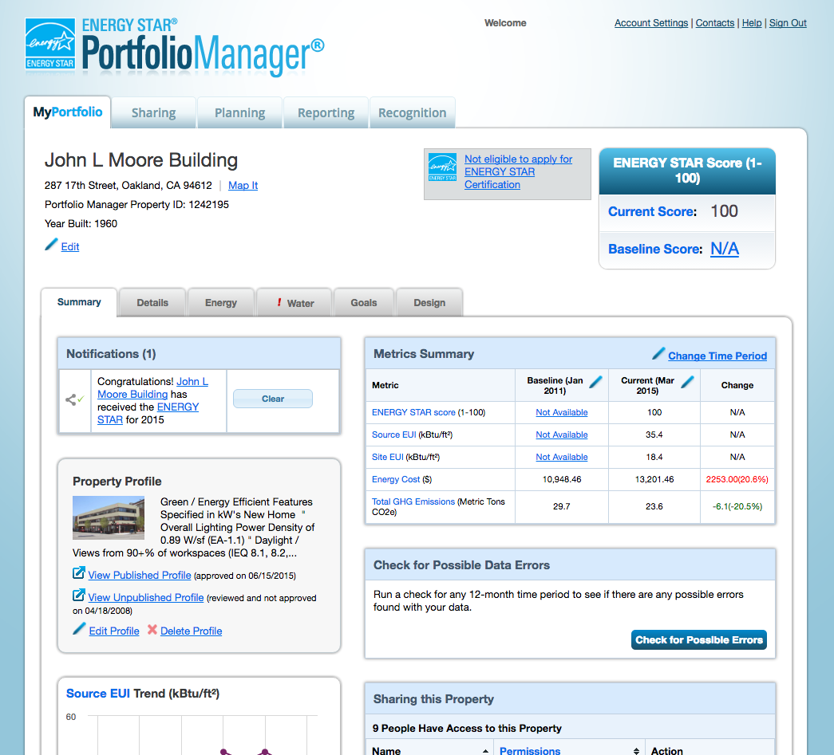
What is Energy Star Portfolio Manager?
Input building characteristics and monthly energy & water use

Slide 12
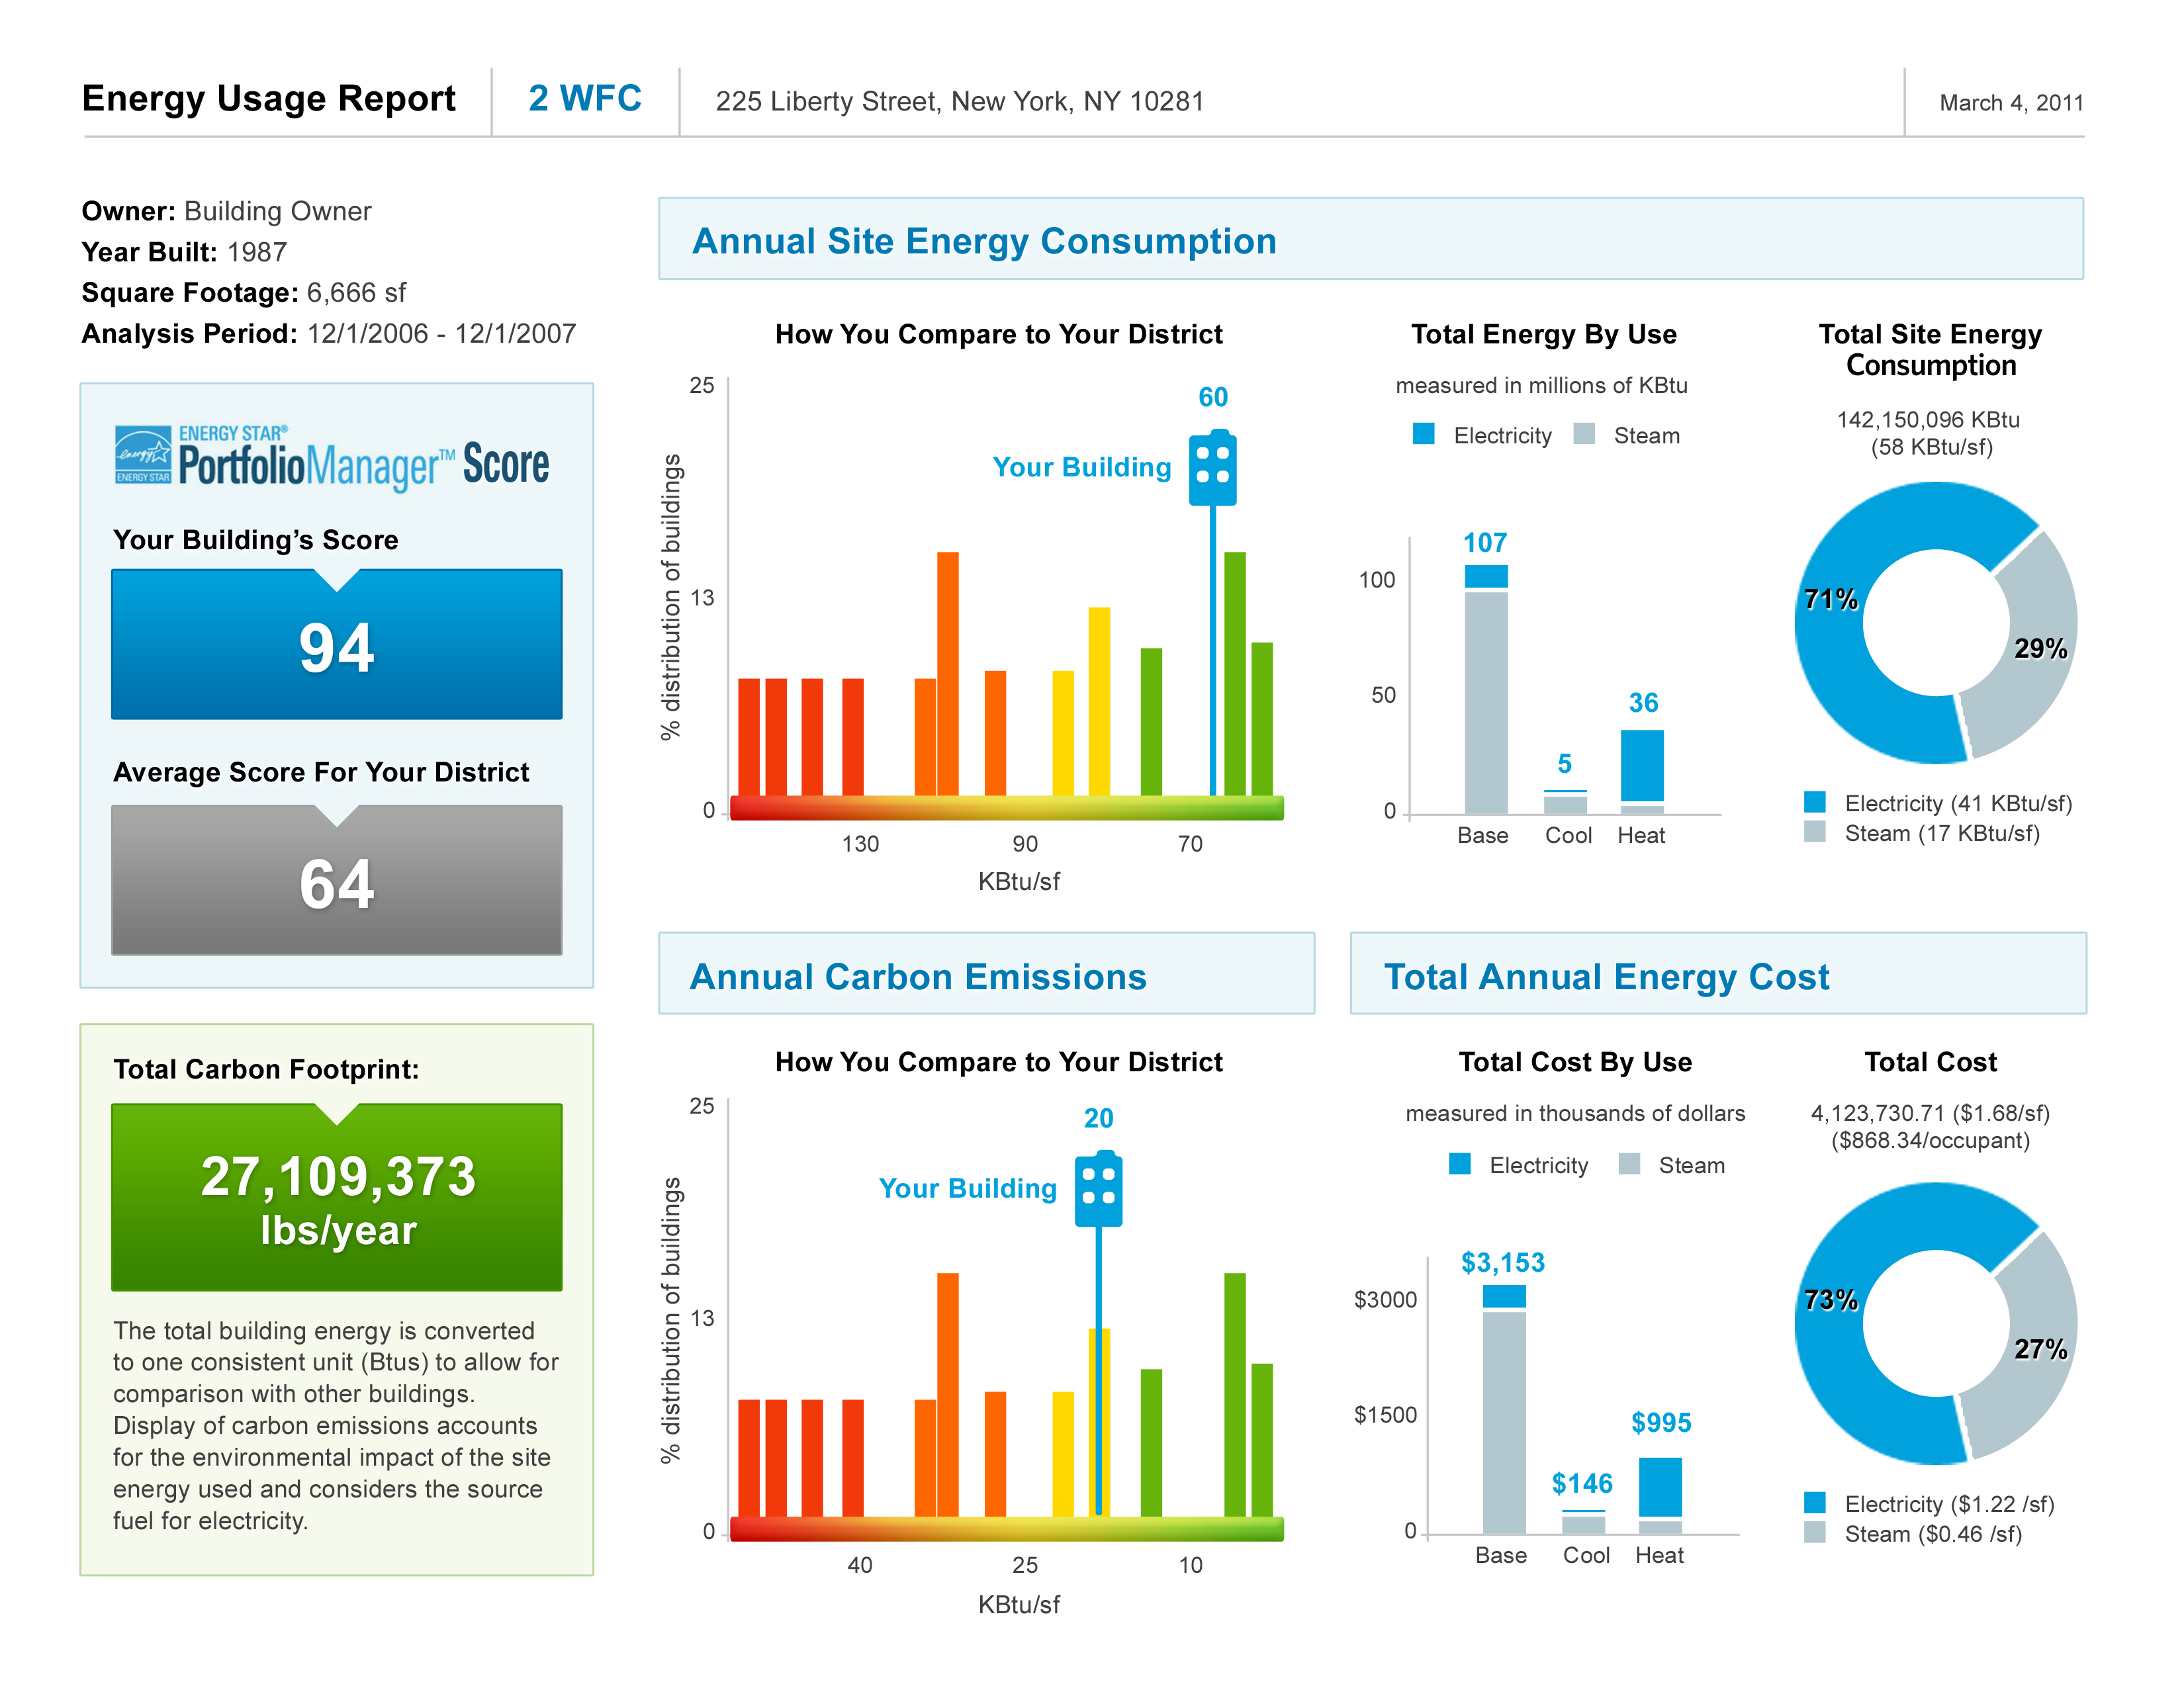
What is Energy Star Portfolio Manager?
Output Report shows benchmarks against EPA’s national database of buildings

Slide 13
Steps for owners to Benchmark
Getting Started
Receive benchmark notification from BPU with a unique building ID (UBID*)
Create Portfolio Manager account and enter property information
Enter Utility Data
Enter data manually, or
Results
Portfolio Manager has QA checks for input values and output results
Data is shared with BPU
Decide to request an exemption
BPU has a help desk to assist with Portfolio Manager
Request data from utility
Assign responsibility – self, staff, or NJ Certified Benchmarker
Receive benchmarking report
* UBID is a building identification standard developed by US-DOE that is based latitude, longitude, and building footprint.
Notes:
We will have a how-to-guide available

Slide 14
Timeline for Building owners
Notifications Sent
~July 1 2023
Data Access Service available
Aug 1, 2023
First Submission
Oct 1, 2023
Notes:
“How to guide” to be published in 2Q.

Slide 15
Requesting aggregated building-level data from a regulated utility
Complete form on utility’s benchmark-ing webpage
Utility matches customers to the building
Owner confirms that list of customers represents the building
Utility checks the consumer protection (4/50) rule
Utility sends aggregated data*
* Depending on the utility, the data is sent directly to the Portfolio Manager account or to the building owner on a spreadsheet, which is then uploaded to Portfolio Manager

Slide 16
Consumer Protection aka 4/50 Rule
The regulated utility will automatically aggregate the customer data for the building if,
There are four or more customers, and
No one customer exceeds 50% of the usage
If the 4/50 rule is not satisfied, then the building owner will have to get consent from individual tenants to release their data. Blank consent letters will be available from the utility
The utility will only aggregate data from consenting tenants

Slide 17
Dealing with data Requests for unregulated utilities
When the annual deadline approaches, building owners in your territory may approach you to request data
If they have a master meter and they are the customer of record, they can enter the data manually or request 13 months of historical data if you offer data downloads, such as a csv file or access to historical billing statements.
If the building has sub-meters
If your policy prohibits the release of data to third-parties
They are permitted to submit data just for their own account for common areas
Otherwise
They will get consent letters signed and submit them to you.
No need to aggregate the data, but returning the data on a spreadsheet helps them submit the data to Portfolio Manager
In exchange for the data, you may request their Portfolio Manager building profile data

Slide 18
If you do decide to provide aggregated data
The EPA Portfolio Manager team has helped utilities of all sizes to develop data access services
Contact Brendan Hall hall.brendan@epa.gov
National Information Solutions Cooperative (NISC)
Developed benchmarking web services offering
Implemented in Colorado
Free for NISC members

Slide 19
BPU Incentives and Programs for non-IOU utilities
BPU has Federal funding to support
Energy efficiency incentive programs
EV charger installations
LED Streetlights
IRA incentivizes whole building solutions
Benchmarking helps building owners understand whole-building consumption
BPU could use Federal funding for municipal water utilities to develop data access service
The data access service could be as simple as allowing customers to download historical billing statements

Slide 20
Questions?
Learn more at https://njcleanenergy.com/commercial-industrial/programs/cea-benchmarking
Philip.chao@bpu.nj.gov

Slide 21
Consumer Data Protection for Electric and Natural gas Suppliers N.J.A.C. 14:4-7.8
(a) Customer information shall not be disclosed, sold or transferred to a third party without the affirmative written consent of the customer or alternative Board-approved consent methodology, except pursuant to 14:4-2.3, or under certain conditions, for example, a third-party performing services directly for a TPS under a binding confidentiality agreement.(b) In the case of a transfer or sale of a TPS, customer consent shall not be required to transfer customer information to the subsequent owner of the business in order to maintain continuity of electric generation service or gas supply service.N.J. Admin. Code § 14:4-7.8

